Slide 1
AI-Driven Decision Making Dashboard
For Businesses
Group - 3
Udit Raj Kumar 2310030232
Dhroov Singh 2310030150
Shubham Deshpande 2310030004
Ashmit Pathak 2310030019

Slide 2
Introduction
Today, businesses generate large amounts of data, making manual analysis difficult and time-consuming. Traditional dashboards provide limited insights and are often not sufficient for effective decision-making.
This project presents an AI-Driven Decision-Making Dashboard that uses artificial intelligence to analyze business data and display meaningful insights through interactive visualizations. It helps organizations make faster, smarter, and data-driven decisions.

Slide 3

01. Project Objective
To develop an AI-driven dashboard for intelligent business decision-making.
Transform raw business data into actionable insights.
Enable real-time monitoring, prediction, and analysis.
Support strategic planning and operational efficiency.

Slide 4

02. Feasibility Analysis
Data sourced from CSV files, APIs, and databases.
Uses existing and widely adopted technologies.
Modular architecture ensures: - Easy implementation - Scalability - Maintainability
Suitable for academic and industry-level deployment.

Slide 5

03. Societal Impact
Promotes data-driven decision.
Reduces reliance on manual analysis and guesswork.
Improves business efficiency and transparency.
Supports sustainable and informed economic growth.
Beneficial for SMEs and large enterprises.

Slide 6

04. Innovation Aspect
Integrates AI and Machine Learning into dashboards.
Provides Predictive insights, Trend detection and Anomaly identification.
Moves beyond static reports to intelligent analytics.
Enables proactive decision-making.

Slide 7
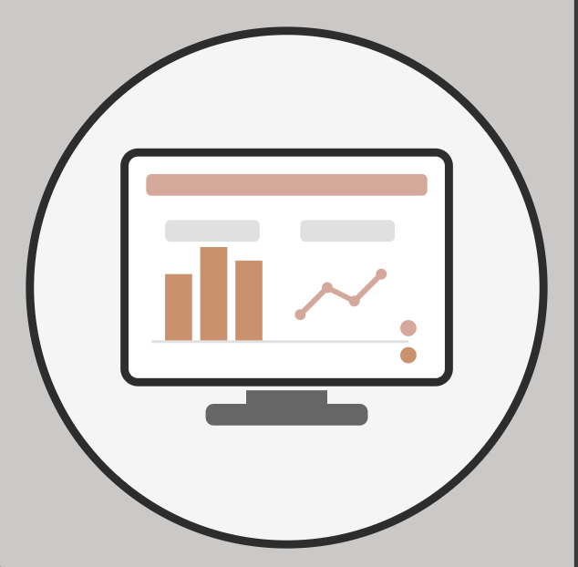
05. Dashboard Design
Clean, interactive, and user-friendly interface.
Real-time KPIs and data visualizations.
Easy navigation for technical and non-technical users.
Structured layout for clear insight presentation.
Responsive and scalable design.

Slide 8

06. Conclusion
The project bridges the gap between data and decisions.
Converts complex datasets into meaningful intelligence.
Enhances business performance and strategy.
Scalable solution with strong future potential.
A practical and innovative AI-based system.

Slide 9
Thank You

